Slide 1

Geopolitical Themed Stressors Extraction from Social Media: A Case Study on Ukraine
Andrea Hannah
December 12, 2023

Slide 2
Table of Contents
Introduction
Prior Related Work
Methods
Results
Limitation
Conclusion

Slide 3
Introduction

Slide 4

Research Introduction
Goal: The goal of this research is to identify the sentiments of Twitter Users around the political and humanitarian climate for Ukraine.
Russia invaded Ukraine on February 20, 2014 in response to the departure of a former pro-Russian President of Ukraine and a perceived threat to its waning influence in the geopolitical region.
This study uses data from the X social media platform from April 2018 as a show case to conduct emotional health analysis and stressor extraction during this disaster event leveraging natural language processing (NLP) and transfer learning techniques.
The emotion prediction algorithm employs EmoRoBERTa-based model to analyze emotion behind each tweet, while the stressor extraction mechanism leverages Latent Dirichlet Allocation (LDA) topic modeling for identification of topics, thus, enabling geopolitical stressor themes extraction through the identified topics and the important terms represented in each topic.

Slide 5
Objectives
Determine the emotion-based stressors related to Ukraine focused tweets in the English Language.
Provide an analysis on sentiments about the geopolitical conflict.

Slide 6
PRIOR RELATED WORK

Slide 7
Topic modeling
Topic modeling creates a way to see patterns and create useful structures from an otherwise unstructured collection of documents.
Topic modeling can create an interdisciplinary pathway between social and computational sciences. This study is inspired from previous research o both current events on Hurricane Harvey using the NLP techniques discussed.
Topic models are probabilistic techniques to uncover the underlying semantic structures of a corpus based on hierarchical Bayesian analysis of the texts, which may include email, scientific abstracts, newspaper archives, etc.

Slide 8
Social media
Social media are defined by the group of Internet-based applications that build on the ideological and technological foundations of Web 2.0, and that allow the creation and exchange of user-generated or shared content.
The term “social media” refers to Internet-based applications, such as TikTok, Instagram, Reddit, Twitter/X, Flickr, Facebook, and YouTube, that enable people to communicate and share resources and information.
Twitter or now, X, is one of the most used social media platforms, is a social network and a microblogging service that allows users to write small pieces of text or messages known as tweets, through which users can interact with each other and express their ideas.

Slide 9
methods

Slide 10
Study Design
Tweet Data Extraction
Data Cleaning and Divide Ukraine Data (3860 tweets) and Palestine Data (3530 tweets)
Conduct Emotion Prediction using EmoRoBERTa
Token Featurization using TF-IDF
LDA Topic Modelling and modify unwanted words to refine Model
Evaluate Topics
Extract Stressors from Topics
Generate Supporting Visualizations including Word Clouds

Slide 11
Study Design
To obtain well-indicated stressors on geopolitical topics, collected tweet data undergoes a text refinement process, where Twitter’s emoji, hexadecimal images, special characters, hyperlinks, and unwanted words are being removed.
We also deploy an emotion classification model to extract tweets with negative emotions to emphasize the stressors’ factors. The original 7,390 tweets were split by Country with Ukraine having 3860 tweets reduced to 834 tweets using EmoRoBERTa and Palestine having 3850 tweets.. Note, the Bidirectional Encoder Representations from Transformers (BERT) structure, namely EmoRoBERTa is utilized to detect emotions. There are 28 tags; each of them represents a distinct emotion for each tweet. The Emotions Distribution are visualized in a table and word clouds were generated.
Then, we apply lemmatization process to avoid redundancy due to words with the same meaning represented under different forms (e.g: go, going, or went are the same verb, with different form due to grammar).
In the next step, we continuously remove English stopwords that are commonly used but contributed little to no meaning for the context, such as "a", "an", "the" and so on. Additionally, words that were redundant to the region prompted place names and people to be removed.
Afterward, we will calculate the term frequency-inverse document frequency (TF-IDF) score for each token before running Latent Dirichlet Allocation model to find the underlying topics in the tweets.
Using an initial number of 5 topics(for time efficiency), we manually filter out tokens that are exceedingly common in each topic such as politician names (e.g. “putin", “zelensky", “biden’, and “obama"), locations (e.g. “ukraine", “russia", or “usa“ and respective demonyms, however ‘American’ could not be filtered out in part of the analysis), or unwanted token that the filtering process fails to catch. This step is repeated after each update on the set of stopwords until LDA model produce clearly distinct topics. Finally, we refine LDA model to form explicit topics by fine-tuning model’s hyper-parameter so that we can manually extract stressors on geopolitical topics precisely.

Slide 12
results

Slide 13
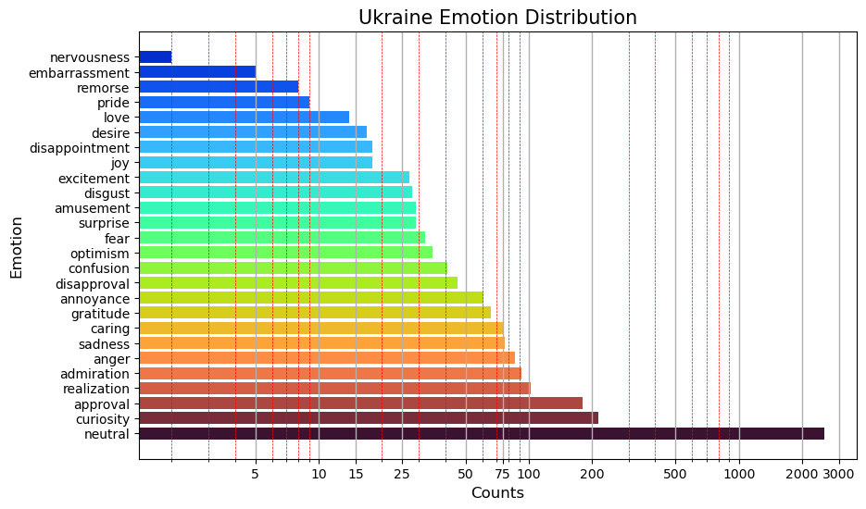
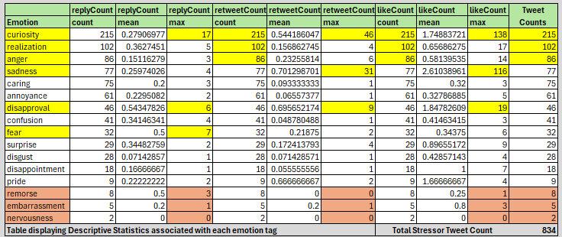
Emoroberta TOTAL EMOTIONS results
After Neutral, the total Ukraine tweets’ (3860) emotions distribution chart shows the highest frequency of emotions are curiosity, approval, realization, admiration, anger, sadness, and caring.
Stressor extraction brings tweets down to a count of 834 and the leading emotions in the stressor summary below shoe curiosity, realization, and anger at higher frequencies. Reply, retweet, and like engagement were higher with curiosity, sadness, disapproval, and fear. Some of the lowest engagement and tweet count involved remorse, embarrassment, and nervousness.

Slide 14
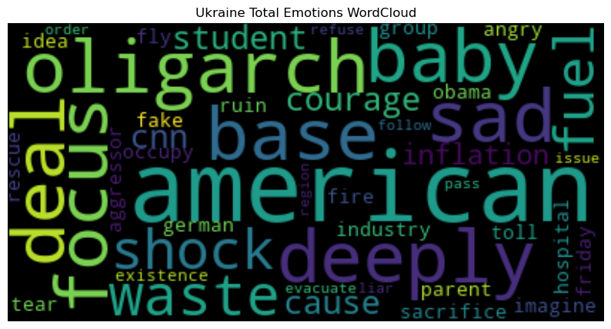
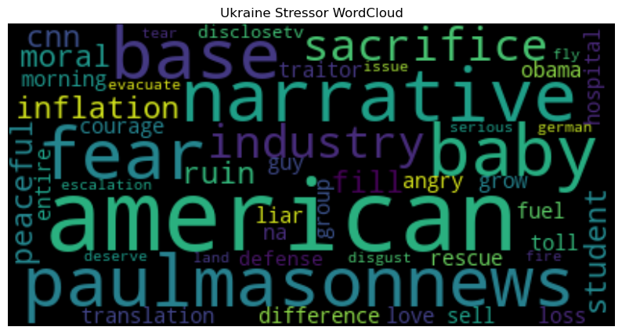
Word Cloud Results
The words within the word clouds are emphasized by size, where the larger the size of the word, the higher frequency that word has our actual data set for our tweets.
The first word cloud focuses on all total tweets of emotions and reflects on the ‘oligarchy’ ‘deal’ making, ‘fuel’, ‘baby’, hospital’, ‘evacuation’, ‘waste’, ‘cause’ of the conflict, acts of ‘courage’, ‘industry’, ‘fire’, ‘fake’ news, ‘occupy’ and the ‘aggressor’, ‘fly’ (attacks and evacuation), ‘sad’, ‘shock’, ‘waste’, ‘anger’, ‘refusal’, ‘orders’, ‘student’, and ‘parent’. Foreign focus was on ‘German’ and ‘Obama’, ‘Americans’, and ‘Base’.
The second word cloud focuses on stressor emotions, and the ‘narrative’, ‘fear’, ‘industry’ as of more importance here. ‘Ruin’ and ‘sacrifice’ along with ‘base’ and ‘Americans’ were hot topics. ‘Inflation’ concerns are raised, ‘morality’ and ‘lies’, ‘peacefulness’ and news networks are mentioned, including ‘CNN’, ‘Paul Mason News’ and ‘Disclosetv’. An emphasis on ‘difference’, ‘love’, ‘sell’, ‘loss’, ‘toll’, ‘translation’, and ‘land’ are made. ‘Rescue’, ‘evacuate’, and ‘courage’ reappear in this second word cloud.

Slide 15
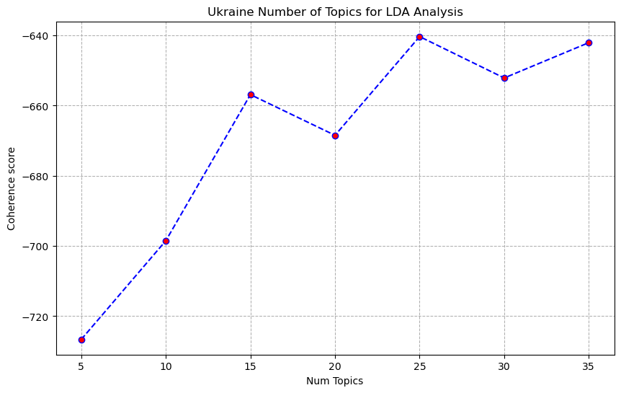
LDA Analysis

Slide 16
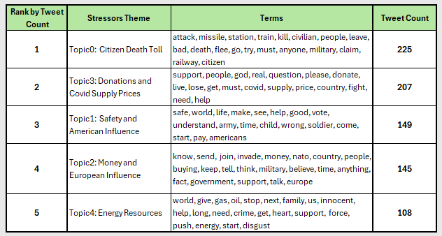
Extracted Geopolitical stressor THEMES Ranked by Tweet count per stressor theme

Slide 17
limitationS

Slide 18
Limitations
Besides time, computational power, and current X research access limitations, here are certain limitations of the study.
The data is self-reported by Twitter’s users which may introduce social desirability biases.
The focus on Twitter’s data solely may not represent the emotional health of individuals across all web platforms or in real life, limiting the generalizability of our findings.
The extraction of stressors manually through main themes discussed on social media may have human bias and dependencies on the identified themes which may neglect stressors in "low volume" discussion.
Finally, our model stems from the absence of context information for each tweet. Unlike other social media platforms, tweets from 2018 can only contain up to 280 characters, and a substantial amount of context is concealed within URL links shared within each message. This can potentially lead to the misclassification of emotions associated with each tweet, thereby limiting our capacity to identify more profound stressors.
The implementation of an efficient information scraper to append this textual data to their respective tweets would significantly enhance our ability to extract more insightful stressors that influence public opinion on the topics of geopolitics. Further research is needed to better understand the advantages and disadvantages of using social media for emotional health assessment and stressor themes extraction in geopolitical conflicts.
There are three technical improvements to consider for this study, which include retaining emojis in the Natural Language Processing steps; increasing the feature count in the tokenizer steps of TF-ID, since there are more tweets in the dataset than the default feature number of 500 represents; and increasing the Topic Number from 5 to a higher optimal number in the LDA Topic Modeling steps.

Slide 19
ConclusionS

Slide 20
Conclusions
This case study focuses on emotions and geopolitical related stressors instead of mental health status as some existing studies focus on.
This study has demonstrated the potential of using NLP techniques and easily available open social media data to explore emotional health using EmoRoBERTa and extract geopolitical related stressors using LDA topic modeling. Word Cloud visualizations reflected a number of negative emotions, such as ‘sad’, ‘angry’, fear’, ‘shock’,
Hopefully, the findings in this study could provide insights for policy makers to handle the needs that arise for geopolitical conflict related emotional health support.
For future work, we will extend the algorithm to more thoroughly to other geopolitical conflict impacting people with more current tweets, extending the study to Palestine. A more comprehensive lexicon for automatic extraction of geopolitical related stressors will be built.

Slide 21
REFERENCE

Slide 22
REFERENCE
Bui, T., Hannah, A., Madria, S., Nabaweesi, R., Levin, E., Wilson, M., Nguyen, L. (2023, December). Emotional Health and Climate Change Related Stressors Extraction from Social Media: A Case Study in Hurricane Harvey. Mathematics. https://www.mdpi.com/journal/mathematics/

Slide 23
ACknowledgements

Slide 24
Acknowledgements
This case study is inspired from previous research on Hurricane Harvey using the NLP techniques discussed.
The Harvey Study researchers include the following:
Thanh Bui 1,† , Andrea Hannah 2,†, Sanjay Madria 3, Rosemary Nabaweesi 4, Eugene Levin 2, Michael Wilson 5, and Long Nguyen 2,∗
1 Department of Electrical Engineering and Computer Science, University of Arkansas, tbui@uark.edu
2 School of Applied Computational Sciences, Meharry Medical College, handrea22@email.mmc.edu,
elevin@mmc.edu, hlnguyen@mmc.edu
3 Department of Computer Science, Missouri University of Science and Technology, madrias@mst.edu
4 School of Graduate Studies, Meharry Medical College, rnabaweesi@mmc.edu
5 APSU GIS Center, Austin Peay State University, wilsonm@apsu.edu
* Correspondence: hlnguyen@mmc.edu
† These authors contributed equally to this work.

